Slide 1
Student Gradebook
By: Ashley Mason, Micah Courtney, and Stephen Green

Slide 2
In our Project we:
Created a code that can read our input file
Created methods and different classes to calculate the students score and average
Used the average to assign a letter grade for the overall grades provided

Slide 3
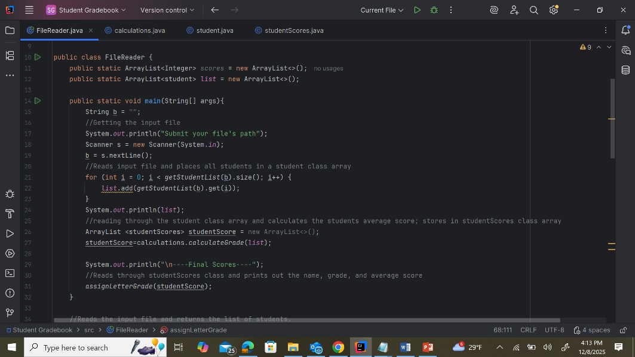
Main Code
Gets the input file
Reads the input file; places all students in a student class array.
Calculation method is called
Assigning letter grade method is called and prints out our result

Slide 4
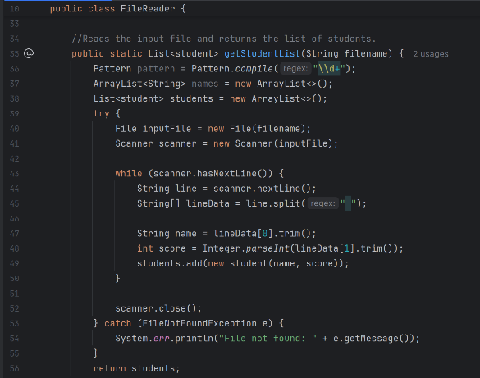
Receiving the file method
Reads the input file and returns the list of students
This is called in the main

Slide 5
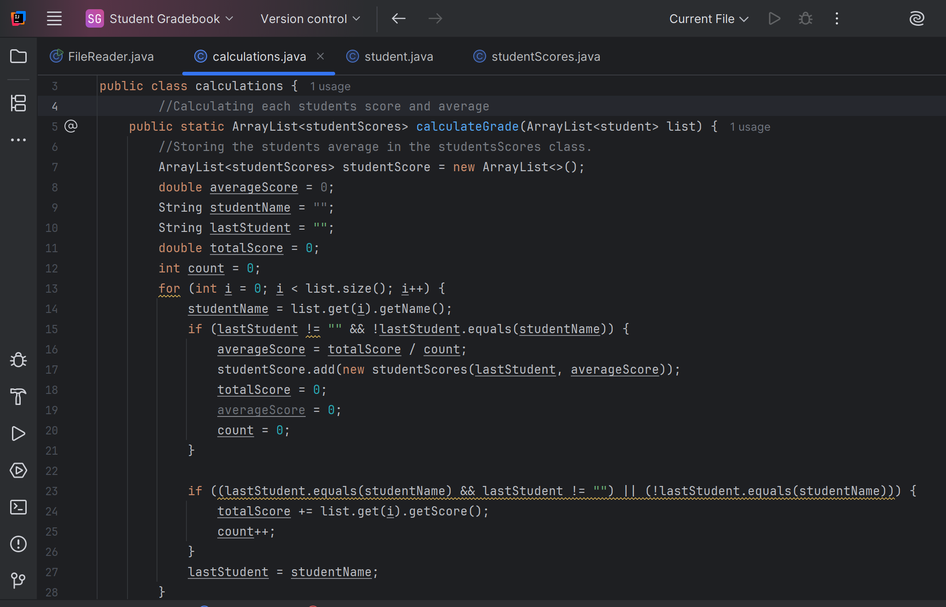
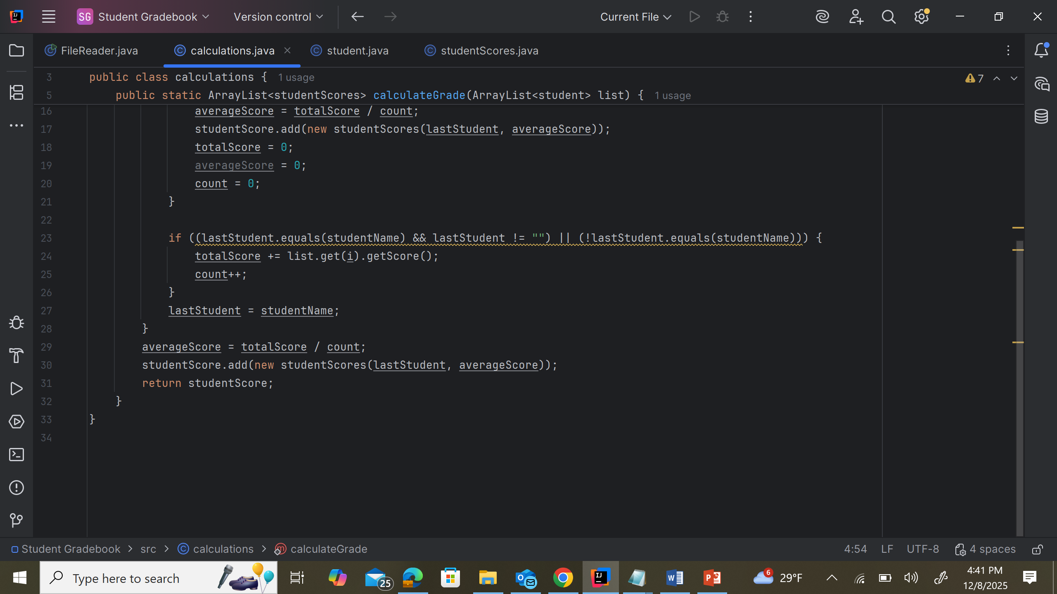
Inside the Calculation Method
Calculates each students score and average
Also stores the students average in the StudentScores class

Slide 6
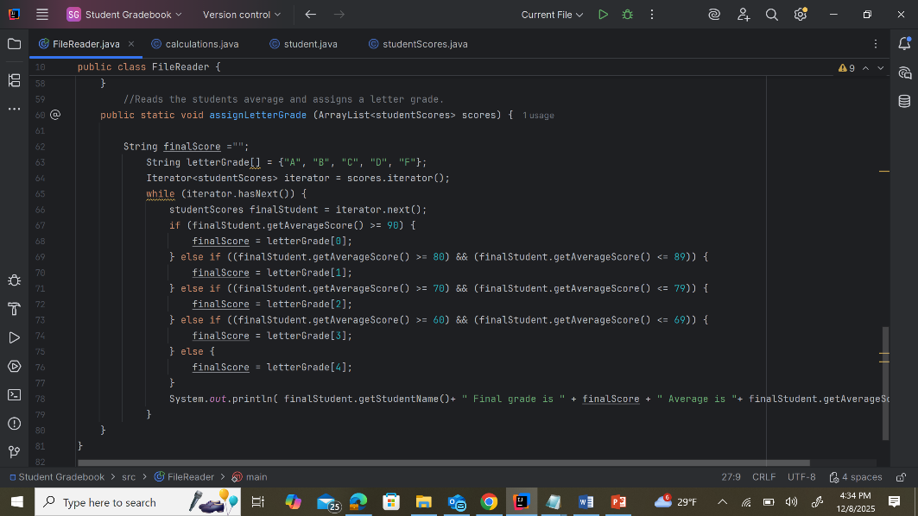
Letter assignment method
Reads the students average to assign the letter grade.

Slide 7
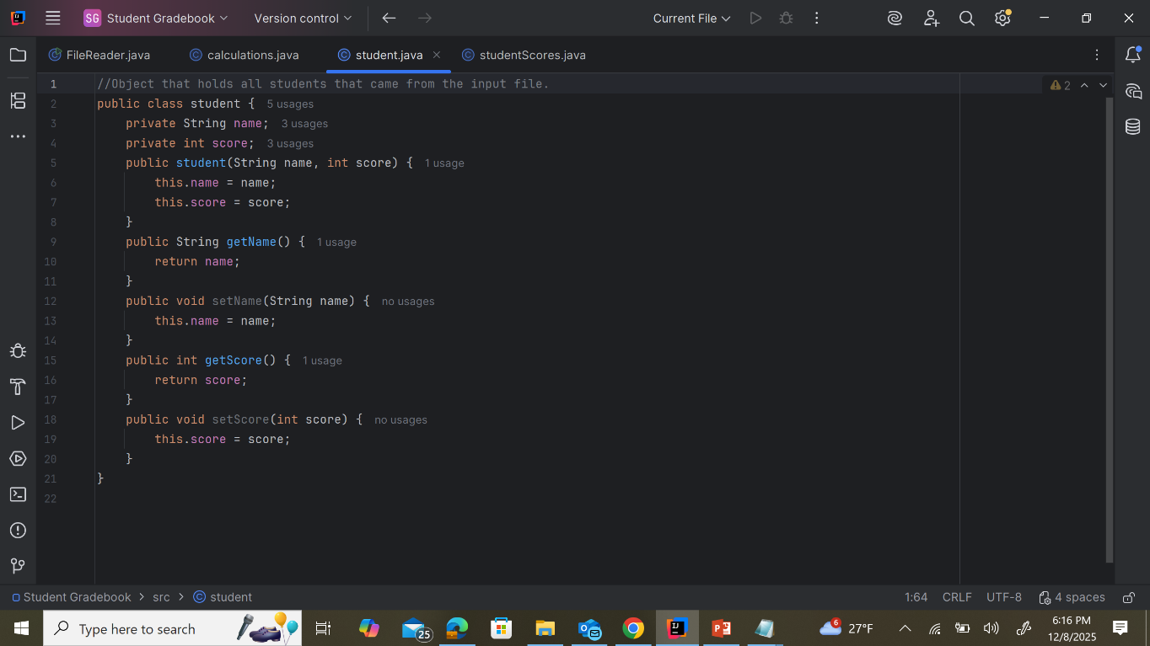
Student Class
This is where all of the student names and scores get held.

Slide 8
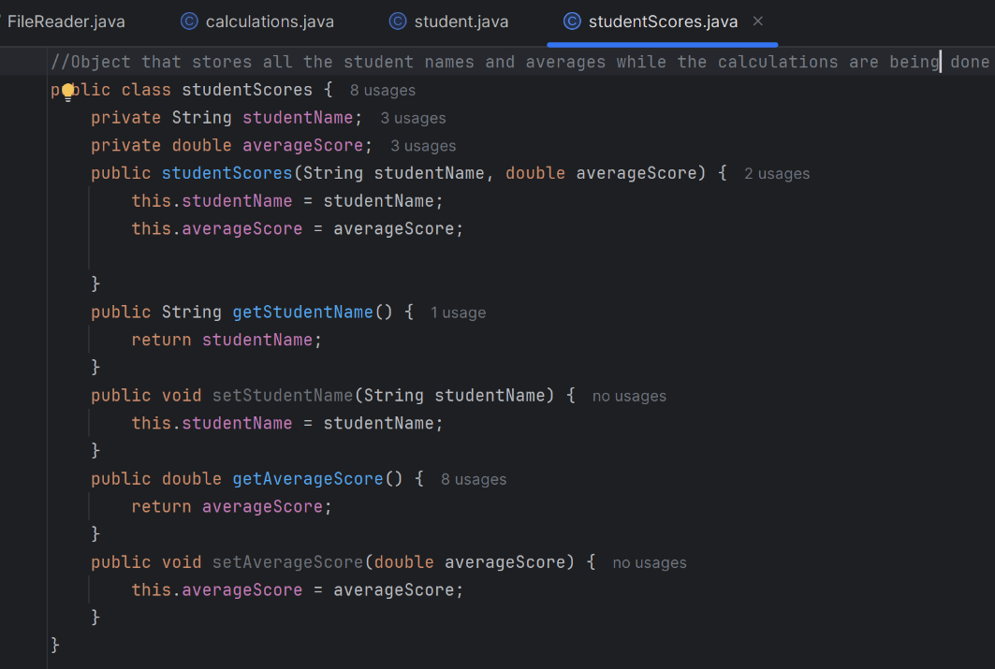
Student Scores Class
This stores the students name with their average while the calculations are being done

Slide 9
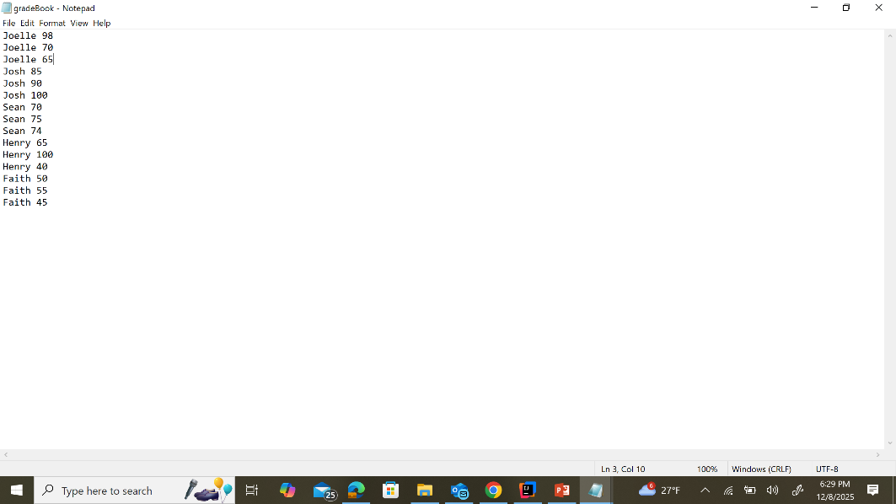
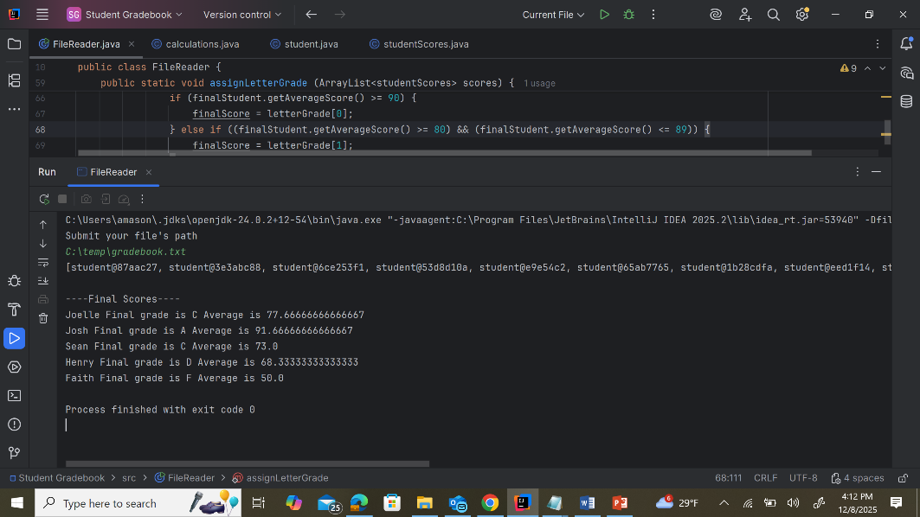
File & Output

Slide 10
Thank You

